Slide 1


Analysis and Design of Algorithms
Transform Coding
Chapter 7: Transform and Conquer
School of Software Engineering © Ye Luo

Slide 2
Transform and Conquer
Three variations of Transform and Conquer tech.
  This group of techniques solves a problem based on a transformation.
  Two stage:
Simpler instance
or
another representation
or
another problem’s instance
Problem’s instance
solution

Slide 3
Transform and Conquer
Three variations of Transform and Conquer tech.
  Differ by what we transform a given instance to:
  instance simplification:
  to a simpler/more convenient instance of the same problem
  representation change:
  to a different representation of the same instance
  problem reduction:
  to a different problem for which an algorithm is already available

Slide 4
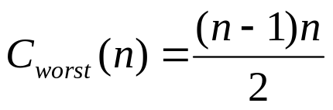
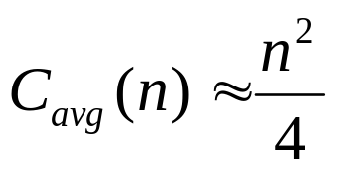

Presorting - Instance simplification
  why interested in sorting?
  many questions about a list are easier to answer if the list is sorted.
  benefit from sorting?
the benefits of a sorted list should more than compensate for the time spent on sorting
generally comparison-based sorting alg. worst case, at least nlogn
Selection Sort Θ (n ²)
Bubble Sort Θ (n ²)
Insertion Sort
Mergesort Θ (n log n)
  Quicksort C_{w}(n) = Θ ( n²) C_{b}(n)=Θ ( n log n) C_{avg}(n)= O( n log n)

Slide 5
Presorting
Presorting --- Instance simplification
  searching
  computing the median (selection problem)
  checking if all elements are distinct (element uniqueness)

Slide 6
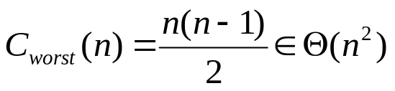
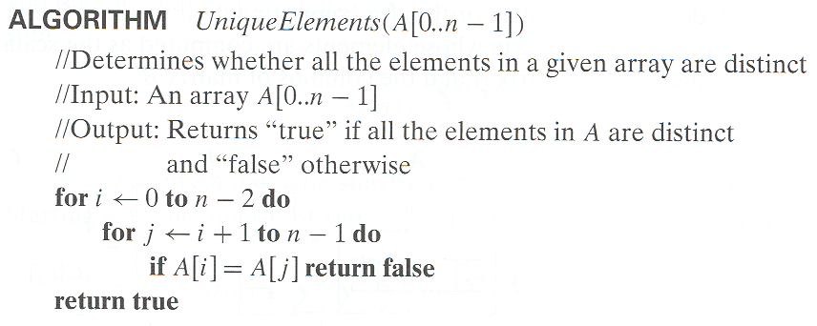
Presorting
Element Uniqueness with presorting
  Element Uniqueness problem --a brute-force method
  compare all pairs of the array’s elements (see Chapt 2)
  until either two equal elements found or no more pairs left

Slide 7
Presorting
Element Uniqueness with presorting
  Element Uniqueness problem -Presorting-based method
  Stage 1: sort by efficient sorting algorithm (e.g. mergesort)
  Stage 2: scan array to check pairs of adjacent elements
  Efficiency Analysis
  sum of
  time spent on sorting : at least nlogn comparisons –determine the overall efficiency
  time spent on checking consecutive elements: no more than n-1 comparisons
  use a good sorting alg.
C(n)=C_{sort}(n)+ C_{scan}(n)= Θ(nlog n) + Θ (n) = Θ(nlog n)

Slide 8
Presorting
Computing a mode
  Mode: a value that occurs most often in a given list of numbers
  Eg. For {5, 1, 5, 7, 6, 5, 7} mode is 5
  Brute-force method
  Idea:
  - Scan the list, compute the frequency of all its distinct values
  - find the value with the largest frequency

Slide 9
Presorting
Computing a mode
  Brute-force method (‘cont)
  implementation:
  - Store the values already encountered, along with their frequencies, in an auxiliary list ( the values in this auxiliary list are all distinct )
  - On each iteration, the ith element of the original list is compared with the values already encountered by traversing this an auxiliary list
  - If a matching value is found, its frequency is incremented;
  - otherwise, the current element is added to the auxiliary list with frequency of 1

Slide 10
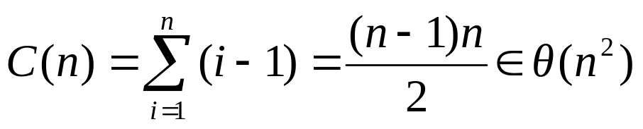
Presorting
Computing a mode
  Brute-force method (‘cont)
  Worst case analysis
  - when a list with no equal elements,
  - i th element is compared with i-1 elements of the auxiliary list
  number of comparisons in creating the frequency auxiliary list
  number of comparisons to find the largest frequency in the auxiliary list n-1

Slide 11
Presorting
Computing a mode
  Computing a mode with presorting
  Idea :
  - sort the input firstly, then all equal values will be adjacent
  - find the longest run of the adjacent equal values in the sorted array
  Efficiency analysis
  sum of
  - time spent on sorting : at least nlogn comparisons –determine the overall efficiency
  - time spent on checking longest run of the adjacent : linear
  Conclusion: using a good sorting algorithm

Slide 12
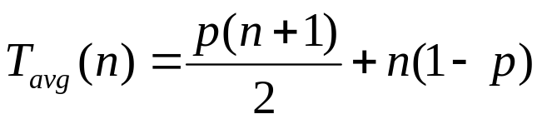
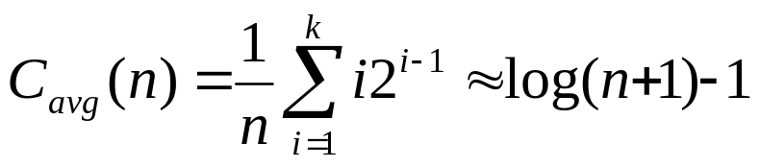
Presorting
Searching problem Search for a given K in A[0..n-1]
  Brute-force method
  sequential search : (see Chapt2)
T _{worst} (n)=n T _{best} (n)=1
  Binary Search (see Chapt5)
  C_{w}(n) = ⎣ log₂ n⎦ +1 = ⎡ log₂ (n+1) ⎤ = Θ (logn)
  C_{b} (n) = 1

Slide 13
Presorting
Searching problem
  Searching with presorting
  sum of C(n)=C_{sort}(n)+ C_{search}(n)= Θ(nlog n) + Θ (log n) = Θ(nlog n)
  time spent on sorting : at least nlogn comparisons –determine the overall efficiency
  time spent on binary search:
  C_{w}(n) = ⎣ log₂ n⎦ +1 = Θ (logn); , C_{avg}(n) = Θ (logn);
  if to search in the same list more than once, the time spent on sorting might be justified

Slide 14
Gaussian Elimination - Instance simplification
Gaussian Elimination 高斯消去法
Problem: Given: a system of n linear equations in n unknowns with an arbitrary coefficient matrix.
Idea:
Stage1: Elementary operations: Transform to an equivalent system of n linear equations in n unknowns with an upper triangular coefficient matrix.
a₁₁x₁ + a₁₂x₂ + … + a_{1n}x_{n} = b₁ a_{1,1}x₁+ a₁₂x₂ + … + a_{1n}x_{n} = b₁
a₂₁x₁ + a₂₂x₂ + … + a_{2n}x_{n} = b₂ a₂₂x₂ + … + a_{2n}x_{n} = b₂
a_{n1}x₁ + a_{n2}x₂ + … + a_{nn}x_{n} = b_{n} a_{nn}x_{n} = b_{n}

Slide 15
Gaussian Elimination - Instance simplification
Gaussian Elimination
Stage2: Solve the latter by backward substitutions starting with the last equation and moving up to the first one.
Specifically:
find the value of x_{n} from the last equation immediately
Substitute this value into the next to last equation to get x_{n-1}
And so on, until we substitute the known values of the last n-1 variables into the first equation, to find the value of x₁

Slide 16
Gaussian Elimination - Instance simplification
Gaussian Elimination What’s Elementary operations
To change from a system with an arbitrary coefficient matrix to an equivalent system with an upper triangular coefficient matrix by
- exchanging two equations of the system
replacing an equation with its nonzero multiple
- replacing an equation with a sum or difference of this equation and some multiple of the former
Specifically
we use a₁₁ as a pivot to make all x₁ coefficients zeros in the equations below the first one
replace the second equation with the difference between it and the first equation multiplied by a₂₁/ a₁₁ to get an equation with zero coefficient for x₁
doing the same for the third, fourth, and finally nth equation – with the multiples a₃₁/ a_{11 ,}a₄₁/ a_{11 ,….} a_{n1}/ a₁₁ of the first equation
Notes:
----which don’t change the system’s solution

Slide 17
Gaussian Elimination - Instance simplification
Gaussian Elimination
e.g.
Solve 2x₁ - x₂ + x₃ = 1
4x₁ + x₂ - x₃ = 5
x₁ + x₂ + x₃ = 0
Gaussian elimination
2 -1 1 1 2 -1 1 1
4 1 -1 5 row2 – (4/2)*row1 0 3 -3 3
1 1 1 0 row3 – (1/2)*row1 0 3/2 1/2 - 1/2 row3–(1/2)*row2
2 -1 1 1
0 3 -3 3
0 0 2 -2
Backward substitution x₃ = (-2) / 2= -1
x₂ = (3- (-3) x₃) / 3 = 0
x₁ = (1 – x₃ –(-1) x₂)/2 = 1

Slide 18
Gaussian Elimination - Instance simplification
Gaussian Elimination
  Two considerations
  if A[i, i] =0
  → exchange the ith row with some row below it with a nonzero coefficient in the ith column
  if A[i, i] is so small that consequently the scaling factor A[j, i]/ A[i, i] so large that new A[j, k] might distorted by a round-off error caused by a subtraction of two numbers of greatly different magnitudes
  → look for a row in the largest absolute value of the coefficient in the ith column, exchange it with the ith row --- partial pivoting

Slide 19
Gaussian Elimination - Instance simplification
Gaussian Elimination
stage1: Elementary operations
Efficiency: Θ(n³) + Θ(n²) = Θ(n³)
ALGORITHM GaussElimination (A[1…n, 1…n], b[1…n])
for i ← 1 to n-1 do
for j ← i+1 to n do
temp ← A[j, i] / A[i, i]
for k ← i to n+1 do
A[j, k] ← A[j, k] - A[i, k] * temp
A[i,i] ?= 0
basic operation: multiplication
stage2: Backward substitution
for j ← n downto 1 do
t ← 0
for k ← j +1 to n do
t ← t + A[j, k] * x[k]
x[j] ← (A[j, n+1] - t) / A[j, j]

Slide 20
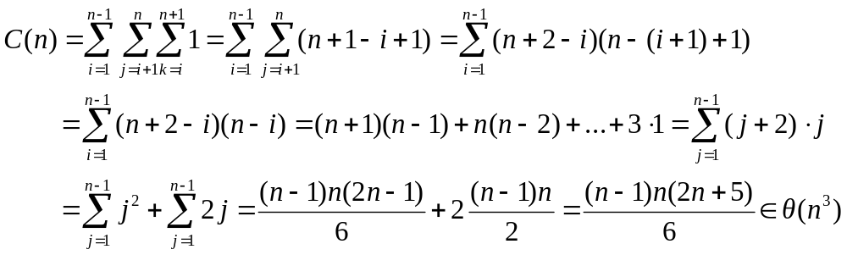
Gaussian Elimination - Instance simplification
Gaussian Elimination
  Efficiency analysis
  stage1: Elementary operations
  stage2: Backward substitution Θ(n²)

Slide 21
Gaussian Elimination - Instance simplification
  Some discussions
Gaussian Elimination either yields an exact solution to a system of linear equations when the system has a unique solution
or discovers that no such solution exists, in this case, the system will have either no solutions or infinitely many of them
the principal difficulty lies in preventing the accumulation of round-off error

Slide 22
Gaussian Elimination
Applications of Gaussian Elimination
  LU decomposition
  Computing a matrix inverse
  Computing a determinant

Slide 23
Heaps and Heapsort
Heaps
  Heap is suitable for implementing priority queues
  maintaining a set S of elements, each with an associated value called a key/priority. It supports the following operations:
  Finding an item with the highest priority
  Deleting an item with the highest priority
  Adding a new item to the multiset
  Notion of the Heap
  A binary tree with keys assigned to its nodes, one key per node
  Shape requirement: the binary tree is essentially complete, i.e. all its levels are full except possibly the last level, where only some rightmost leaves may missing
  Parental dominance requirement: for max-heap:
  key at each node ≥ keys at its children
…

Slide 24
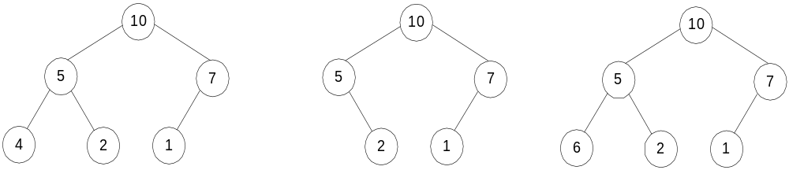
Heaps and Heapsort
Heaps
  E.g.
Heap’s elements are ordered top down ( a sequence of values along any path down from its root is decreasing or non-increasing if equal keys are allowed )
but they are not ordered left to right
a heap
not a heap
not a heap

Slide 25
Heaps and Heapsort
Heaps
  Properties of Heaps
  There exits exactly one essentially complete binary tree with n nodes, its height is ⎣ log₂n⎦
  Height of a node: the number of edges on the longest simple downward path from the node to a leaf.
  Height of a tree: the height of its root.
  level of a node: A node’s level + its height = h, the tree’s height.
  The root of a heap always has the largest key (for a max-heap)
  A node of a heap considered with all its descendants is also a heap
  (The subtree rooted at any node of a heap is also a heap)
  Max-heap property and min-heap property
  Max-heap: for every node other than root, A[PARENT(i)] >= A(i)
  Min-heap: for every node other than root, A[PARENT(i)] <= A(i)

Slide 26
Heaps and Heapsort
Heaps
  Properties of Heaps
  it is more efficient to implement a heap as an array, by storing the heap’s elements in top-down left-to-right order
  - Parental nodes are represented in the first ⎣n/2⎦ locations of the array
  Leaf keys occupy the last ⎡ n/2⎤ locations
  Relationships between indexes of parents and children.
PARENT(i) LEFT(i) RIGHT(i)
return ⎣i/2⎦
9
return 2i
return 2i+1
5
3
1 2 3 4 5 6
1
4
2
9 5 3 1 4 2

Slide 27
Heaps and Heapsort
Heaps Construction
How to construct a heap with the given list of keys?
  Bottom-up Heap construction
  Build an essentially complete binary tree by inserting n keys in the given order.
  Heapify the tree
  Starting with the last (rightmost) parental node, heapify/fix the subtree rooted at it; if the parental dominance condition does not hold for the key at this node:
  exchange its key K with the key of its larger child
  Heapify/fix the subtree rooted at the K’s new position
  until the parental dominance requirement for K is satisfied
  Proceed to do the same for the node’s immediate predecessor.
  Stops after this is done for the tree’s root.

Slide 28
Heaps and Heapsort
Heaps Construction
Bottom-up Heap construction (A Recursive version)
ALGORITHM HeapBottomUp(H[1..n])
//Constructs a heap from the elements
//of a given array by the bottom-up algorithm
//Input: An array H[1..n] of orderable items
//Output: A heap H[1..n]
for i ← ⎣n/2⎦ downto 1 do
MaxHeapify(H, i)
Given a heap of n nodes, what’s the index of the last parent? ⎣n/2⎦
ALGORITHM MaxHeapify(H, i)
l ← LEFT(i)
r ← RIGHT(i)
if l <= n and H[l] > H[i]
then largest ← l
else largest ← i
if r <= n and H[r] > H[largest]
then largest ← r
if largest ≠ i
then exchange H[i] ←→H[largest]
MaxHeapify(H, largest)

Slide 29
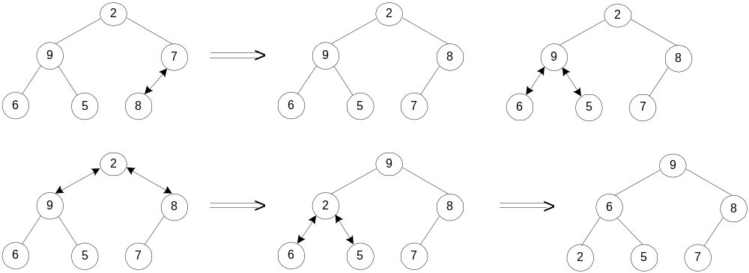
Heaps and Heapsort
Heaps Construction
  Bottom-up Heap construction(‘cont)
  Example 1: Construct a heap for the list 2, 9, 7, 6, 5, 8
  Example 2: 4 1 3 2 16 9 10 14 8 7 → 16 14 10 8 7 9 3 2 4 1

Slide 30
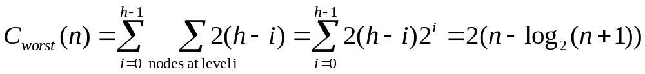

Heaps and Heapsort
Heaps Construction
  Worst-Case Efficiency for Bottom-up
  assume n =2^{k}-1, so the heap is full, the maximum number of nodes occurs on each level
  Worst case: each key on level i will travel to the leaf level h
  height of the tree h= ⎣ log₂n⎦
  moving to the level down needs two comparisons
  one to find the larger child
  one to determine whether the exchange is required
  number of key comparisons for a key on level i: 2(h-i)

Slide 31
Heaps and Heapsort
Heaps Construction
  Top-down Heap Construction
  Successive insertions of new key into a previously constructed heap
  Insertion of a new key K
  Insert the new node with key K at the last position in heap, i.e. after the last leaf of the existing heap
  sift K up to its appropriate position
  Compare with its parent, and exchange them if it violates the parental dominance condition.
  Continue comparing the element with its new parent,
  until K is not greater than its last parent or it reaches the root
Ex: add 10 to heap: 9 6 8 2 5 7
9
9
10
6
8
6
10
6
9
2
5
7
10
2
5
7
8
2
5
7
8

Slide 32
Heaps and Heapsort
Heaps Construction
  Efficiency for Top-down
  height of a heap with n node: h= ⎣ log₂n⎦
  Inserting one new element to a heap with n-1 nodes requires no more comparisons than the heap’s height
  time efficiency for Top-down insertion is O(log₂n)

Slide 33

Heaps and Heapsort
Heaps Construction
  Root Deletion
  swap the root with the last leaf K
  Decrease the heap’s size by 1
  Heapify the smaller tree by sifting K down the tree, in exactly the same way in Bottom-up Heap construction
  verify the parental dominance for K,
  if it holds, we done.
  if not, swap K with the larger of its children
  and repeat this operation until parental dominance holds for K in its new position.

Slide 34
Heaps and Heapsort
Heaps Construction
  Efficiency for Root Deletion
  It can’t make key comparison more than twice the heap’s height
  Efficiency: 2h ∈ Θ(logn)
Ex: 9 8 6 2 5 1

Slide 35
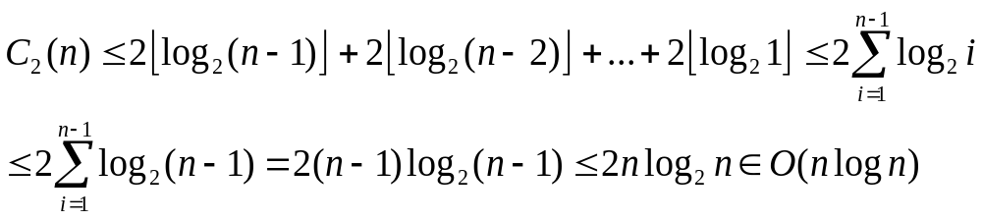
Heaps and Heapsort
Heapsort
  Analysis of Heapsort
  Bottom-up heap construction O(n)
  Root deletion, Repeat n-1 times until heap contains just one node
  Analysis shows that C₁(n)+C₂(n)=Θ(nlogn), in both the worst and average cases, the same class as mergesort
  But not require extra storage ---implemented with arrays
  Experiments show that heapsort runs more slowly than quicksort but competitive with mergesort

Slide 36
Horner’s Rule- Representation change
Horner’s Rule For Polynomial Evaluation 霍纳法则
  Problem
  Polynomial Evaluation: Compute the value of a polynomial
  p(x) = a_{n}x^{n} + a_{n-1}x^{n-1} + … + a₁x + a₀ (1)
  at a specific point x --- fast Fourier Transform, FFT
  Two brute-force algorithms
p ← 0
for i ← n down to 0 do
power ← 1
for j ← 1 to i do
power ← power * x
p ← p + a_{i} * power
return p
p ← a₀; power ← 1
for i ← 1 to n do
power ← power * x
p ← p + a_{i} * power
return p

Slide 37
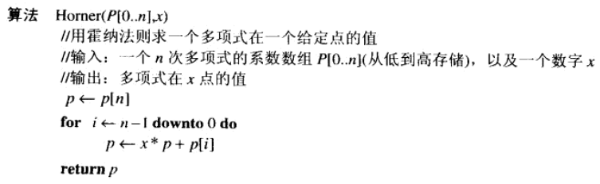
Horner’s Rule- Representation change
Horner’s Rule For Polynomial Evaluation
  Horner’s Rule --Representation change
  Obtained from (1), successively taking x as a common factor in the remaining polynomials of diminishing degrees
  p(x) = (… (a_{n}x +a_{n-1}) x + …) x + a₀ (2)

Slide 38
Horner’s Rule- Representation change
Horner’s Rule For Polynomial Evaluation
  Horner’s Rule --Representation change
  Obtained from (1), successively taking x as a common factor in the remaining polynomials of diminishing degrees
  p(x) = (… (a_{n}x +a_{n-1}) x + …) x + a₀ (2)
E.g.: p(x) = 2x⁴ - x³ + 3x² + x - 5 = x(2x³ - x² + 3x + 1) - 5 =
= x(x(2x² - x + 3) + 1) - 5 = x(x(x(2x - 1) + 3) + 1) – 5
To evaluate p(x) at x=3
coefficients | 2 | -1 | 3 | 1 | -5
x=3 | 2 | 3*2+(-1) = 5 | 3*5+3=18 | 3*18+1=55 | 3*55+(-5)=160

Slide 39
Problem Reduction
Problem Reduction
  To solve a problem, reduce it to another problem that you know how to solve
  two points:
  finding a problem to which the problem at hand should be reduced
  reduction-based algorithm to be more efficient than solving the original problem directly
reduction
alg. A
Problem 1
to be solved
Problem 2
solvable by alg. A
solution
to Problem 2

Slide 40
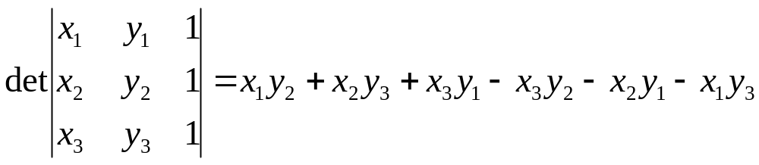
Problem Reduction
Problem Reduction
  E.g. in analytical geometry, for three arbitrary points in the plane, p₁= (x₁, y₁), p₂= (x₂, y₂), p₃= (x₃, y₃) , the determinant is positive if and only if the point p₃ is to the left of the directed line through points p₁ p₂
  i.e. we reduce a geometric problem about the relative locations of three points to a problem about the sign of a determinant.
the entire idea of analytical geometry is based on reducing geometric problems to algebra ones.

Slide 41
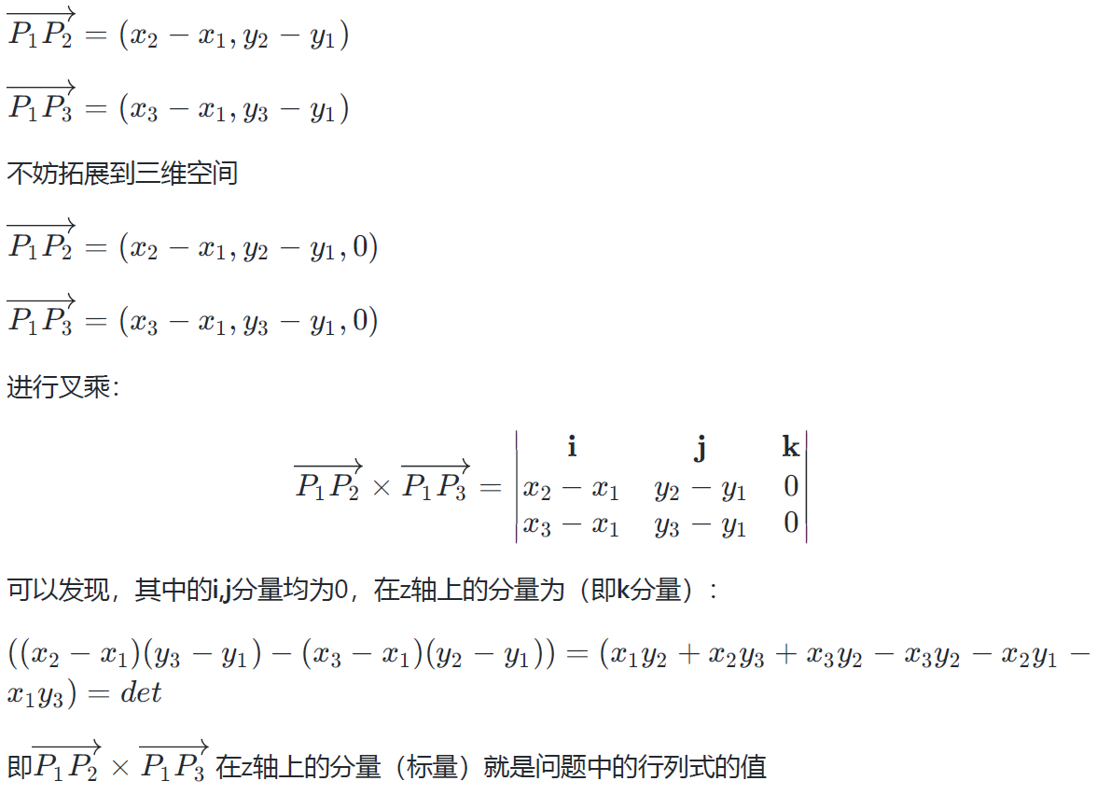
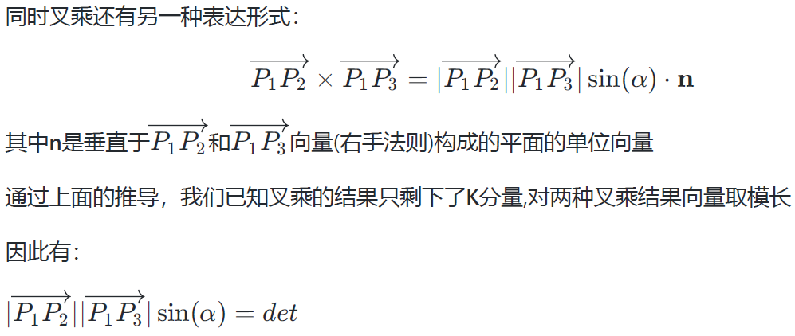
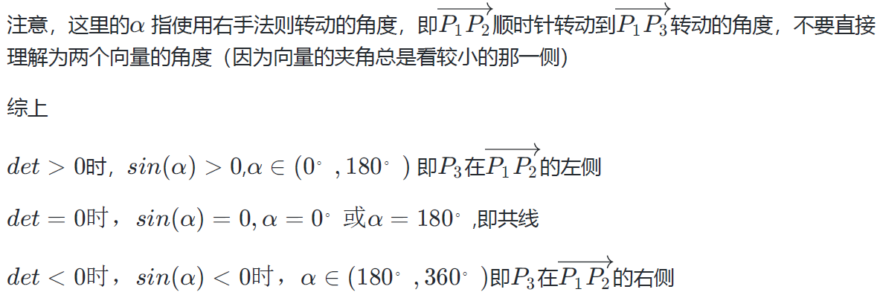
Problem Reduction
Problem Reduction
  E.g. in analytical geometry, for three arbitrary points in the plane, p₁= (x₁, y₁), p₂= (x₂, y₂), p₃= (x₃, y₃) , the determinant is positive if and only if the point p₃ is to the left of the directed line through points p₁ p₂

Slide 42
Problem Reduction
Linear programming
  Linear programming:
  a problem of optimizing a linear function of several variables subject to constraints in the form of linear equations and linear inequalities.
    Maximize(or minimize) c₁x₁+ …c_{n}x_{n}
    Subject to a_{i1}x₁+…+ a_{in}x_{n} ≤ (or ≥ or =) b_{i}, for i=1…n
    x₁ ≥ 0, …, x_{n} ≥ 0

Slide 43
Problem Reduction
Linear programming
  Algorithms for Linear programming:
  simplex method: worst-case efficiency is to be exponential
  Ellipsoid algorithm: polynomial time.
  Interior-point methods: polynomial time
  Karmarkar’s alg.: polynomial worst-case efficiency
  Integer Linear programming: the variables of a Linear programming problem are required to be integers.
  no known polynomial-time alg.
  branch-and-bound method for solving Integer Linear programming

Slide 44

Problem Reduction
Linear programming
  Investment Problem:
  Scenario
  A university endowment needs to invest $100million
  Three types of investment:
  Stocks (expected interest: 10%)
  Bonds (expected interest: 7%)
  Cash (expected interest: 3%)
  Constraints
  The investment in stocks is no more than 1/3 of the money invested in bonds
  At least 25% of the total amount invested in stocks and bonds must be invested in cash
  Objective:
  An investment that maximizes the return

Slide 45
Problem Reduction
Linear programming
  Investment Problem: (‘cont)
  mathematical model
  Maximize 0.10x + 0.07y + 0.03z
  subject to x + y + z = 100
  x ≤ (1/3)y
  z ≥ 0.25(x + y)
  x ≥ 0, y ≥ 0, z ≥ 0
  optimal decision making problem ----→ linear programming problem

Slide 46
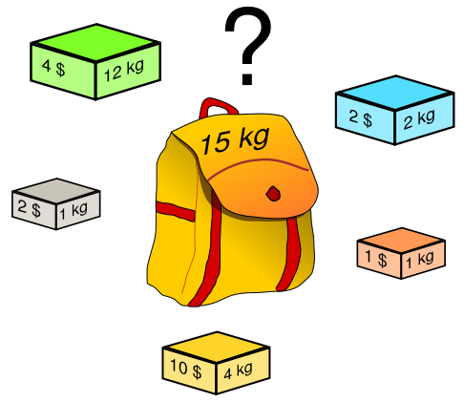
Problem Reduction
Linear programming
  Knapsack Problem (Continuous/Fraction Version):
  Scenario
  Given n items:
  weights: w₁ w₂ … w_{n}
  values: v₁ v₂ … v_{n}
  a knapsack of capacity W
  Constraints
  Any fraction of any item can be put into the knapsack, x_{i}
  Objective:
  Find the most valuable subset of the items

Slide 47
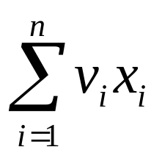
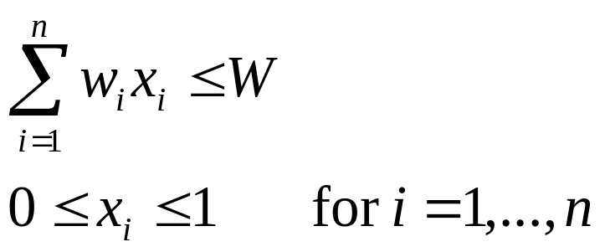
Problem Reduction
Linear programming
  Knapsack Problem (Continuous/Fraction Version): (‘cont)
  mathematical model
  Maximize
  subject to

Slide 48
Problem Reduction
Linear programming
  Knapsack Problem (Discrete Version)
  Scenario
  Given n items:
  weights: w₁ w₂ … w_{n}
  values: v₁ v₂ … v_{n}
  a knapsack of capacity W
  Constraints
  an item can either be put into the knapsack in its entirely or not be put into the knapsack.
  Objective:
  Find the most valuable subset of the items

Slide 49
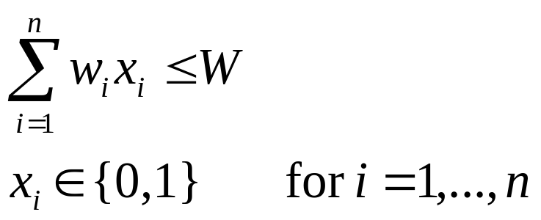
Problem Reduction
Linear programming
  Knapsack Problem (Discrete Version) (‘cont)
  mathematical model
  Maximize
  subject to

Slide 50
Problem Reduction
Reduction to Graph
  many problems can be solved by reduction to one of the standard graph problems
  state-space graph: vertices of a graph represent possible states of the problem, edges indicate permitted transitions among such states
  one of the graph’s vertices represents the initial state, another represents a goal state of the problem
  puzzles and games
  not always a straightforward task
  problem ----→ a path from the initial-state vertex to a goal-state vertex

Slide 51
Problem Reduction
Reduction to Graph
  River-crossing puzzle
  Problem: The wolf, goat and bag of cabbage puzzle.
  A peasant must transport a wolf, goat and bag of cabbage from one side of a river to another using a boat
  the boat can only hold one item in addition to the peasant ,
  subject to the constraints that the wolf cannot be left alone with the goat , and the goat cannot be left alone with the cabbage .

Slide 52
Problem Reduction
Reduction to Graph
  River-crossing puzzle
  state-space graph
Pg
Pwgc
wc ||Pg
P
Pwc ||g
Pw
c ||Pwg
Pc
Pg
Pgc ||w
w ||Pgc
Pc
Pg
Pwg ||c
Pw
g ||Pwc
P
Pg ||wc
Pg
|| Pgwc

Slide 53
Summary
变治法是一种基于变换思想，把问题变换成一种更容易解决的类型。
变治法的三种类型：实例化简，改变表现，和问题化简
变治法三种类型对应的算法举例
堆的概念，堆排序的思想：在排列好堆中的数组元素后，再从剩余堆中连续删除最大的元素。在最差以及平均情况下，该算法都属于在位的排序算法，时间复杂度⊙(nlogn)
高斯消去法
霍纳法则
线性规划及整数线性规划

